Slide 1
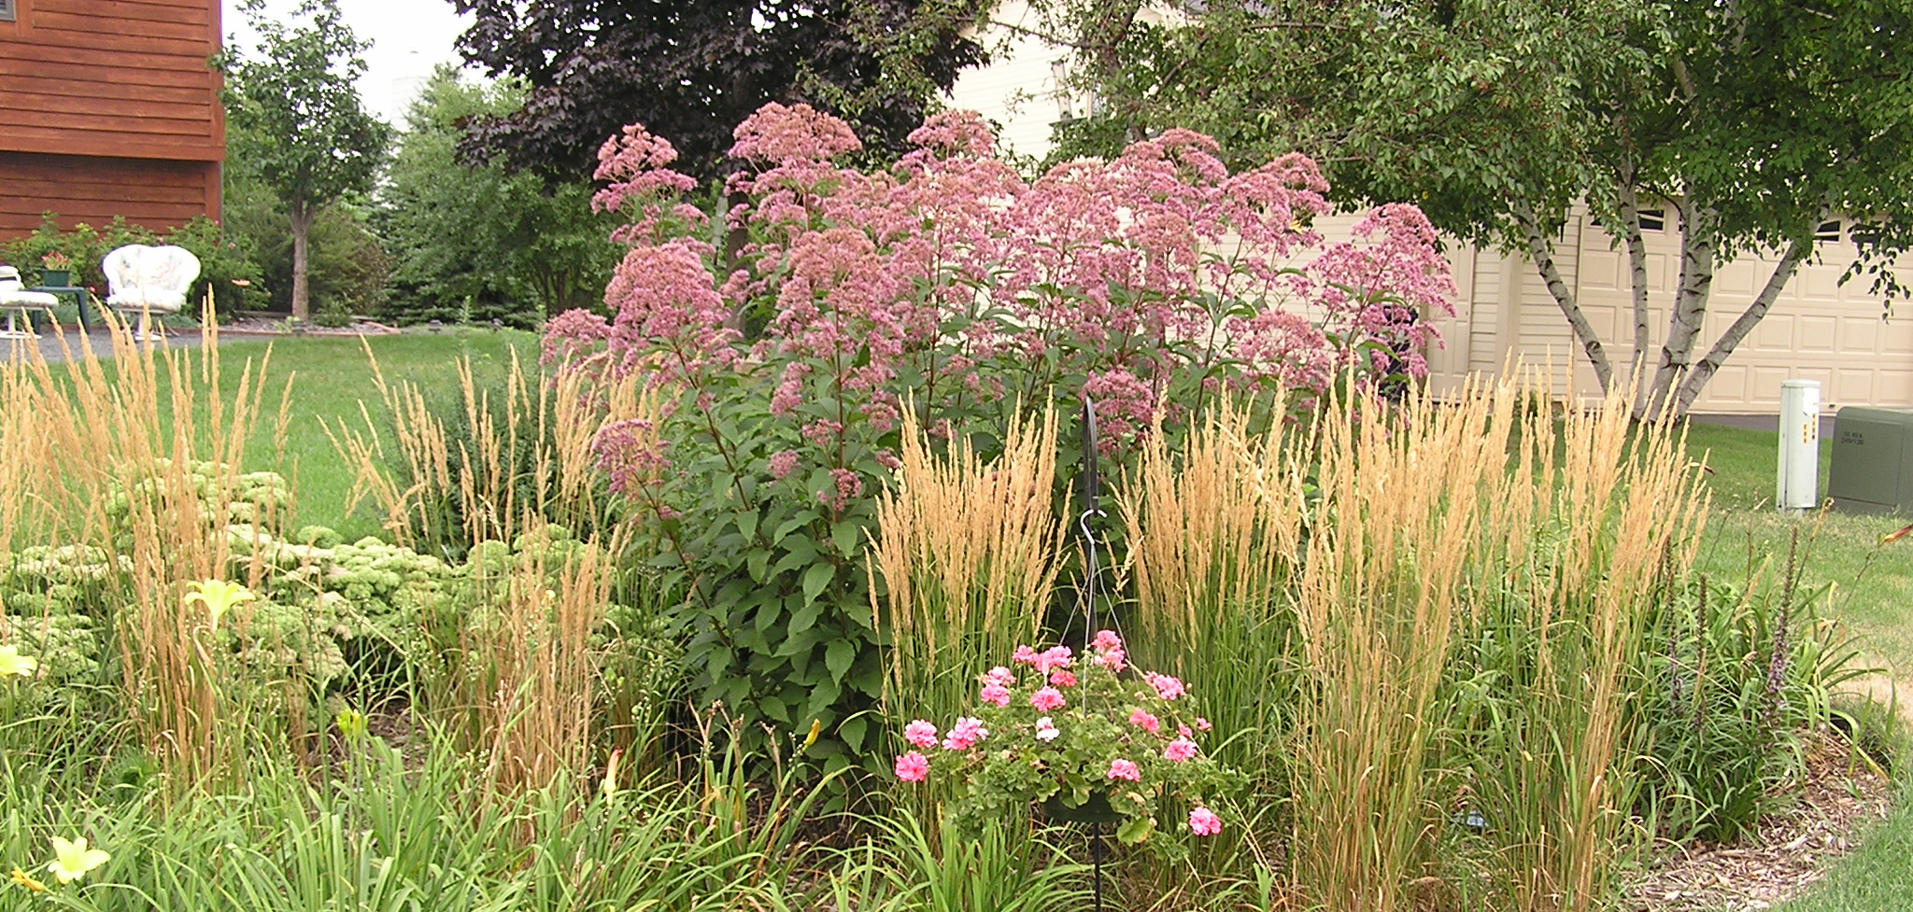

Phosphorus and Biofiltration:
What can we do?
Andy Erickson, Ph.D., P.E.
Research Associate, St. Anthony Falls Laboratory, University of Minnesota
MPCA Webinar: Maximizing Stormwater BMPs for Phosphorus Removal
January 9, 2018. St. Paul, MN (webcast)
Photo courtesy: B. Asleson

Slide 2
Acknowledgements
Collaborators:
  John S. Gulliver (UMN)
  Peter T. Weiss (Valparaiso University)
Sponsors & Partners:
  UMN, EPA/MPCA, LCCMR, CWL, LRRB, City of Prior Lake, PLSLWD, Scott WMO, others
  BWSR, RWMWD, MWMO, Carver County, Dakota County, Wright County, VLAWMO, CLFLWD, CRWD, ACD, and many others!
THANK YOU!!

Slide 3
Bioretention: Bioinfiltration vs. Biofiltration
Bioinfiltration (no underdrains)
Biofiltration (underdrains)
Media: Construction Sand, top soil, organic matter (compost)
Images courtesy: MN Stomwwater Manual at https://stormwater.pca.state.mn.us/index.php?title=Bioretention_terminology.
Source: https://stormwater.pca.state.mn.us/index.php?title=Design_criteria_for_bioretention

Slide 4

Vegetative Processes
Vegetation in bioretention cells removes more nitrogen and phosphorus than non-vegetated cells (Lucas and Greenway 2008, 2011).
Longer contact time results in more nitrogen and phosphorus removal in vegetated cells.
Plant uptake accounts for little phosphorus removal, but most of the nitrogen removal.
Rhizospheric microbial activity accounts for significant phosphorus removal.
Sources: Lucas, W. C., and Greenway, M. (2008). "Nutrient retention in vegetated and nonvegetated bioretention mesocosms." Journal of Irrigation and Drainage Engineering-ASCE, 134(5), 613-623.
Lucas, W.C. and Greenway, M. (2011) Phosphorus Retention by Bioretention Mesocosms Using Media Formulated for Phosphorus Sorption: Response to Accelerated Loads. Journal of Irrigation and Drainage Engineering-ASCE 137(3), 144-153.

Slide 5
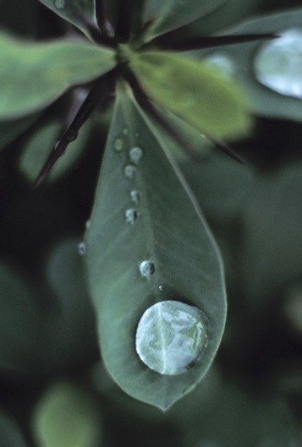
Biological: Compost and Petroleum Hydrocarbons
Petroleum Hydrocarbons are captured in rain gardens through sorption.
Biodegradation prevents accumulation of
petroleum hydrocarbons.
Rain gardens are an effective option for
sustainably treating petroleum hydrocarbons
in stormwater.
Source: LeFevre, G.H., R.M. Hozalski, and P.J. Novak. (2012). "The Role of Biodegradation in Limiting the Accumulation of Petroleum Hydrocarbons in Raingarden Soils." Water Research, 46(20), 6753–6762. http://dx.doi.org/10.1016/j.watres.2011.12.040.

Slide 6
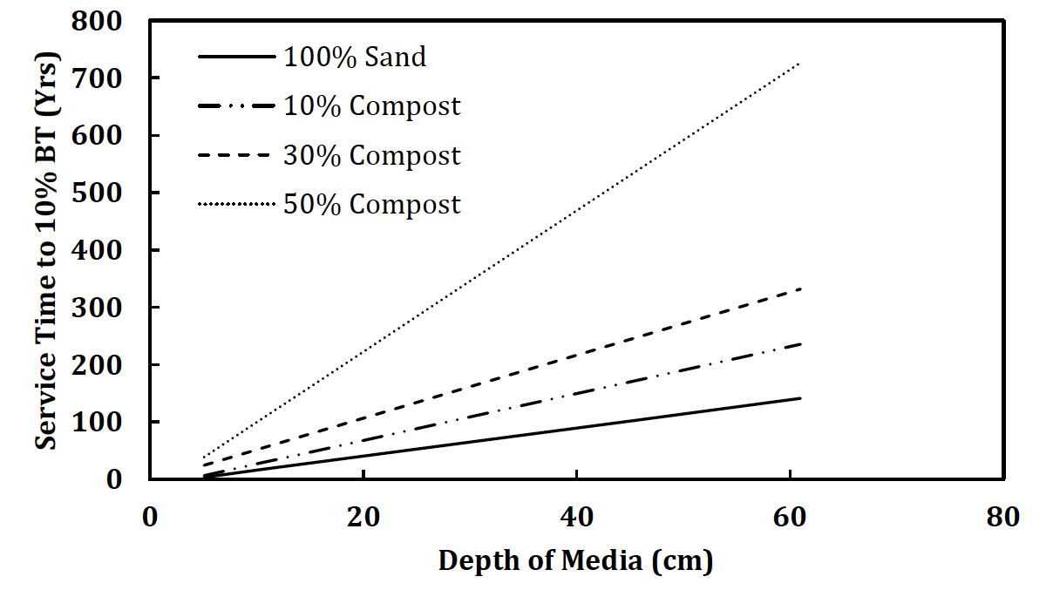
Chemical: Metals Sorption to Compost
(Expected Lifespan; Zinc at 10%)
Longer for Cadmium
12 inches
Source: Morgan, J. G., Paus, K. A., Hozalski, R. M., and Gulliver , J. S. (2011). "Sorption and Release of Dissolved Pollutants Via Bioretention Media." Project Report 559. St. Anthony Falls Laboratory, University of Minnesota, Minneapolis, MN.

Slide 7
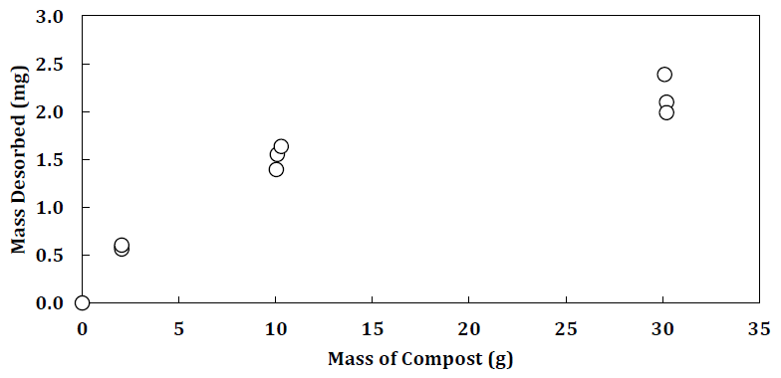
Phosphorus Leaching from Compost
What about from naturally organic (top)soils?
Source: Morgan, J. G., Paus, K. A., Hozalski, R. M., and Gulliver , J. S. (2011). "Sorption and Release of Dissolved Pollutants Via Bioretention Media." Project Report 559. St. Anthony Falls Laboratory, University of Minnesota, Minneapolis, MN.

Slide 8
What can we do?
Reduce organic matter
  3 to 5% may be sufficient
Test for phosphorus content
  MN Stormwater Manual
Amend with Commercial sorbents
Image Courtesy: MN Composting Council

Slide 9
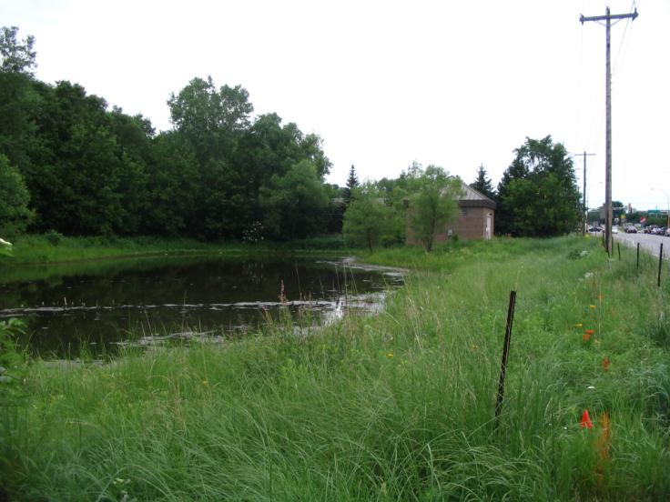
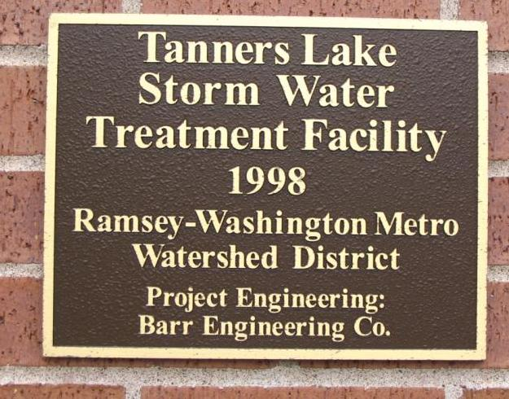
Chemical: Alum Coagulation and Flocculation
Images Courtesy: Ramsey Washington Metro Watershed District

Slide 10
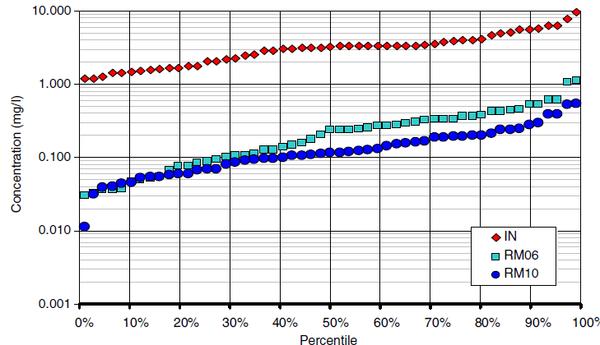
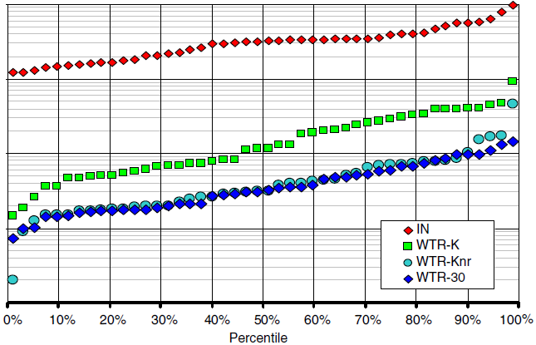
Phosphorus Sorption to Alum (WTR) Amendments in Rain Gardens
Inflow
15% WTR, restricted flow
15% WTR, unrestricted flow
Water treatment residuals (WTRs) result from coagulating dissolved organic acids and mineral colloids with either aluminum or iron sulfate.
CAUTION:
Dosing
Impurities
30% WTR
Source: Lucas, W.C. and Greenway, M. (2011) Phosphorus Retention by Bioretention Mesocosms Using Media Formulated for Phosphorus Sorption: Response to Accelerated Loads. Journal of Irrigation and Drainage Engineering-ASCE 137(3), 144-153.
Other studies: O’Neill, S. W. and Davis, A. P. (2010). Analysis of Bioretention Media Specifications and Relationships to Overall Performance. Proceedings of the 2010 LID conference. April 11 - 14, San Francisco, CA.

Slide 11
Chemical: Commercial Sorbents
Various Commercial Products available for nutrients, metals, hydrocarbons, pesticides, toxics, among others
Some have third-party testing, some not
All require media replacement to remain effective for the long-term

Slide 12
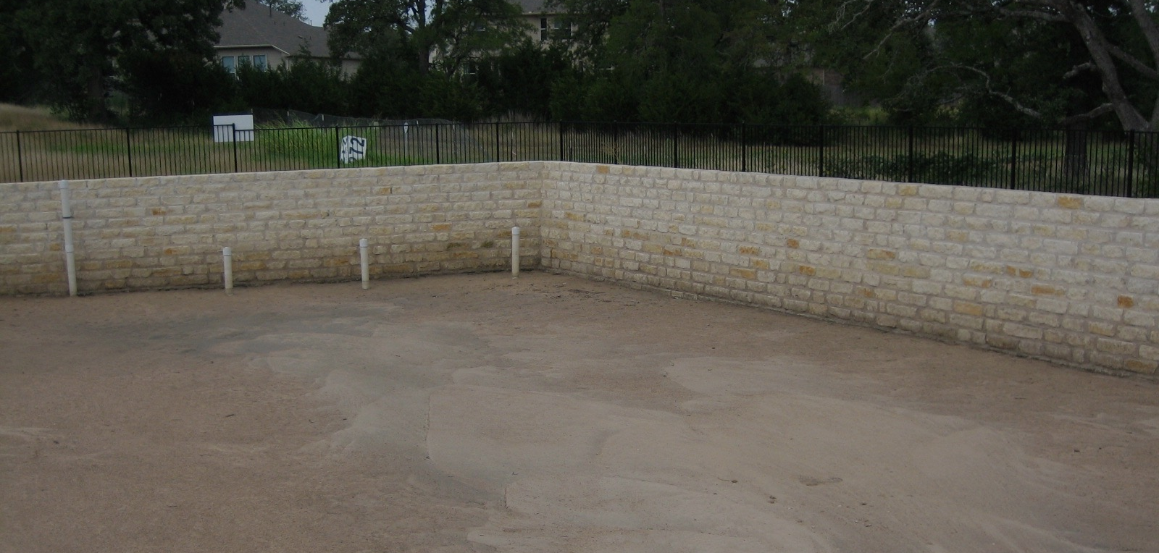
Chemical: Phosphorus Sorption with Iron
Sand Filtration (C33 sand, d50 = 0.3 mm)
  Particulate capture > 80%
Enhanced Sand Filtration
  Steel wool increases dissolved phosphorus capture via surface sorption to iron oxide
Source: Erickson, A.J., Gulliver, J.S. and Weiss, P.T. (2007) Enhanced sand filtration for storm water phosphorus removal. Journal of Environmental Engineering-ASCE 133(5), 485-497.

Slide 13
Experimental Results: Iron Enhanced Sand Filtration, SAFL
n = 112
n = 336
n = 336
n = 336
n = 112

Slide 14
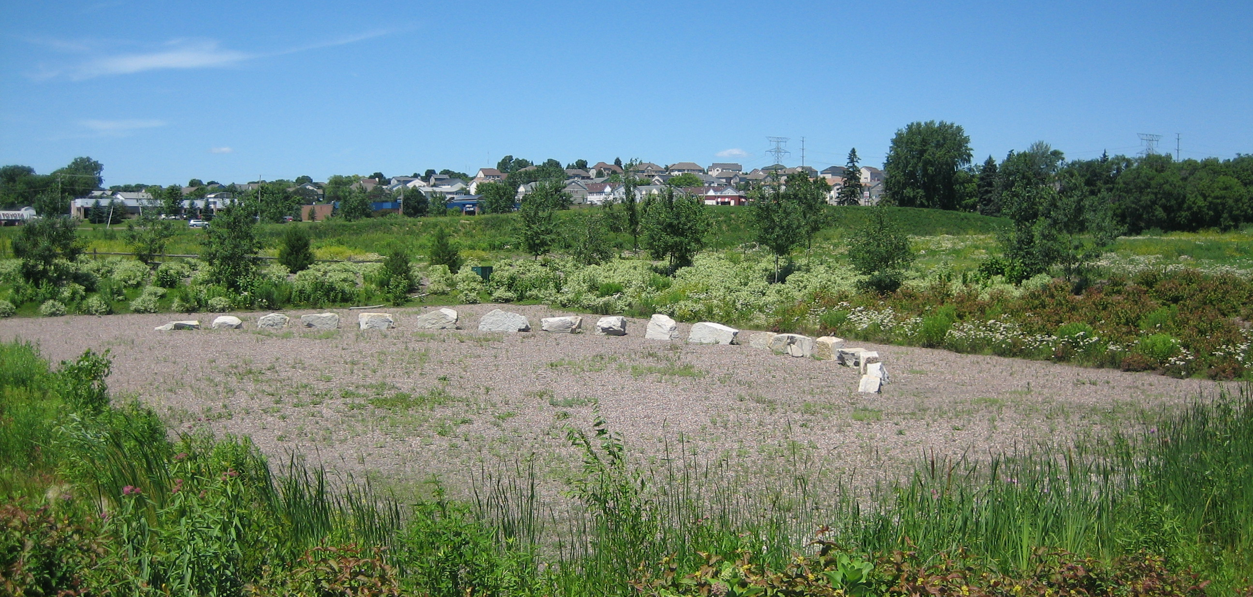
MN (Iron Enhanced) Filter
(5% Iron Filings, Maplewood, MN)

Slide 15
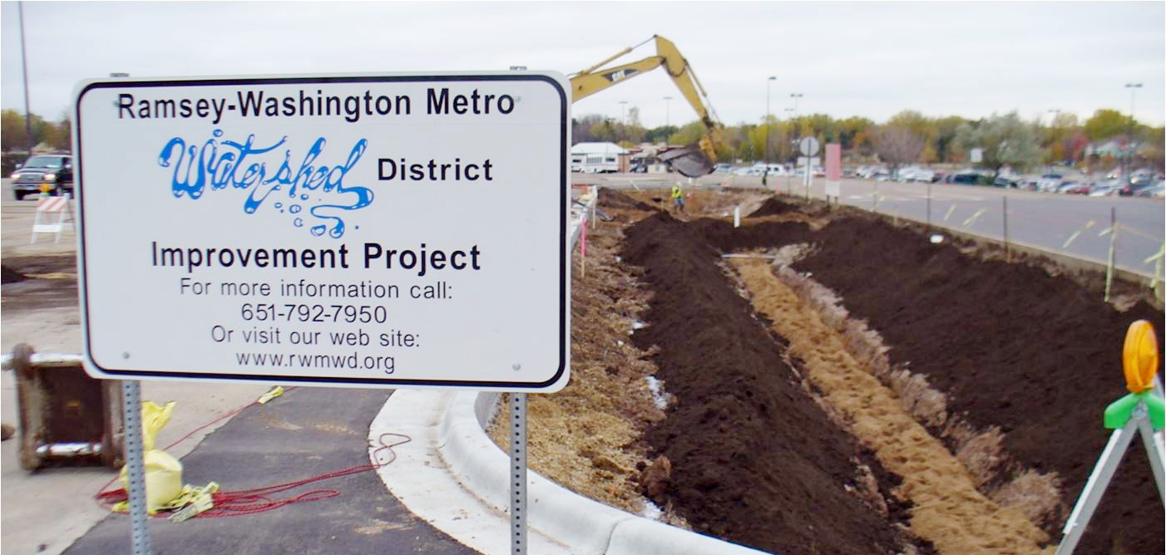
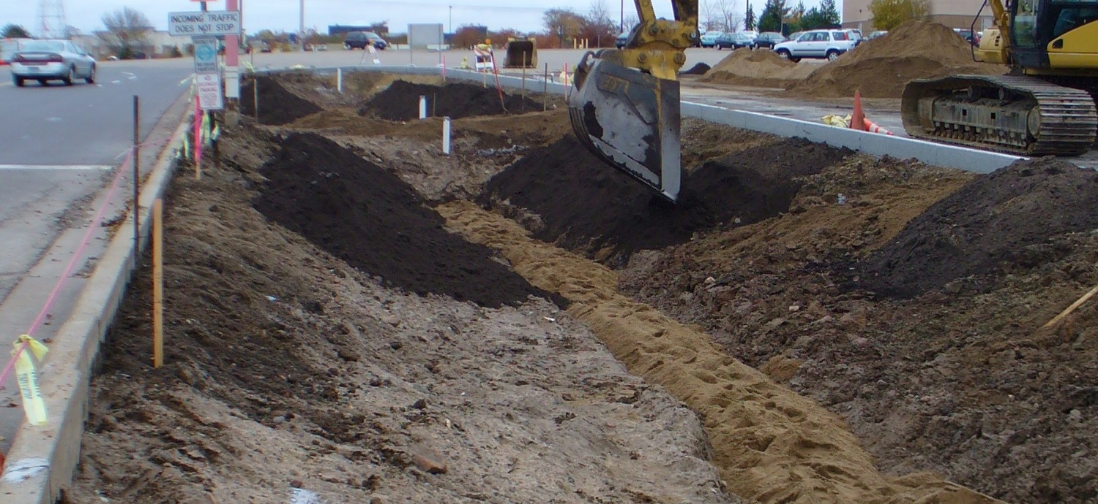
MN Filter for Bioretention (Maplewood, MN)
Bioretention Soil Mix
Iron Enhanced Sand Filter Trench
Photo Courtesy: Barr Engineering Company

Slide 16
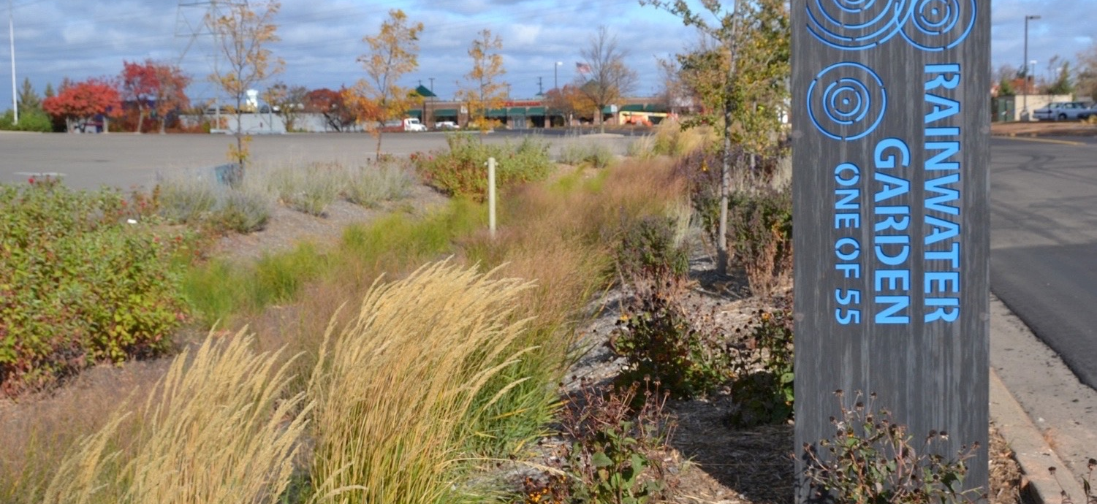
MN Filter for Bioretention (Maplewood, MN)
Photo Courtesy: Barr Engineering Company

Slide 17




MN Filter Layered Bioretention/Rain Garden
(Valparaiso, IN)
Gravel Subbase and under-drain
Compost Amended Sand
Iron Enhanced Sand
Underdrain
Natural Soil

Slide 18
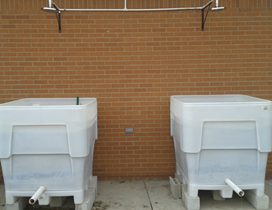
Experimental Iron-Enhanced Rain Gardens
(Valparaiso, IN)
Assess gardens constructed in plastic boxes with drain tile
15 cm gravel (2.5-5 cm) layer
46 cm sand (+ iron) layer
30 cm compost (15%) and sand (85%) mix
Slide Courtesy: P. Weiss
Photo Courtesy: Pete Weiss

Slide 19
Results
Slide Courtesy: P. Weiss

Slide 20
CAUTION: Not all Iron is Created Equal
Consider the following:
  Iron content (30% – 90+%)
  Impurities (e.g., Cd, Cu, Cr, lubricants)
  Reactive
  Particle size (silts – coarse sand)
Images Courtesy: periodictable.com

Slide 21
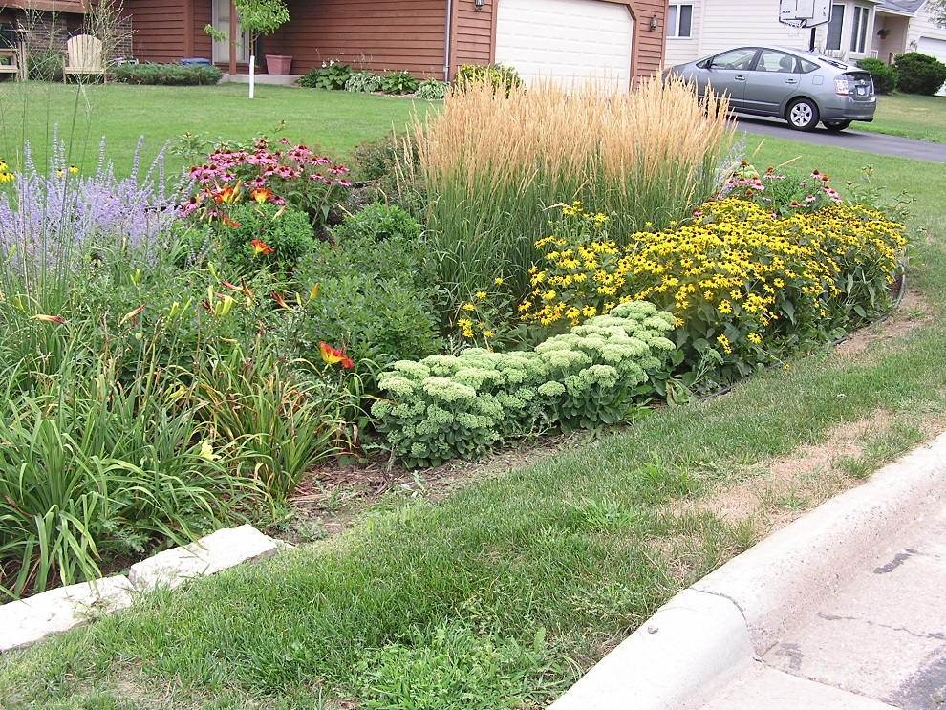
Dissolved Pollutants & Biorention Practices
LeFevre, Paus, Natarajan, Gulliver, Novak, and Hozalski. (2015). "A Review of Dissolved Pollutants in Urban Stormwater and their Removal and Fate in Bioretention Cells." Journal of Environmental Engineering, 141 (1).
  Nutrients (Sorption →Phosphorus, Microbial →
  Nitrogen, Vegetation → Nutrients)
  Toxic Metals (Filtration, Sorption, Plant Uptake)
  Organic Pollutants
  Removal and Fate in Bioretention (Volatilization,
  Sorption, Biodegradation, Vegetative Processes)
Photo courtesy: B. Asleson

Slide 22

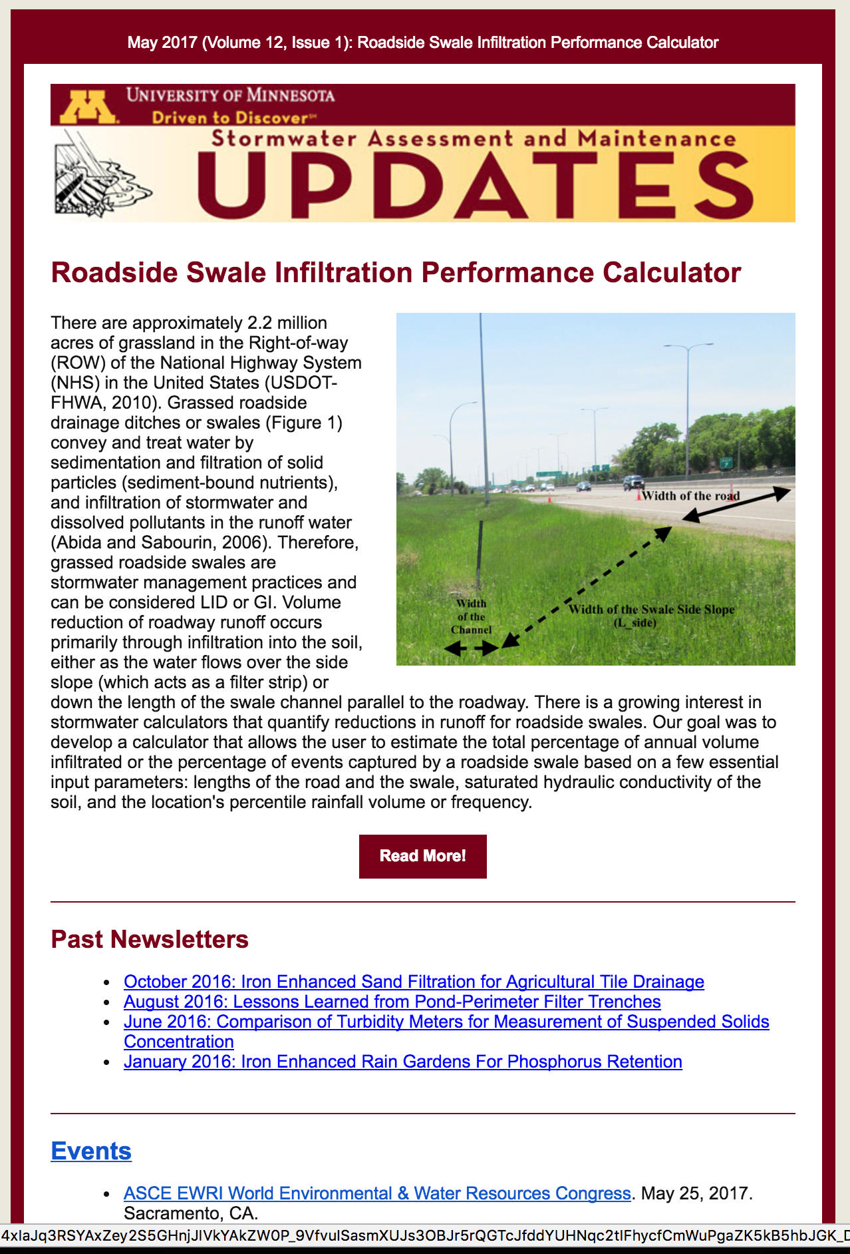
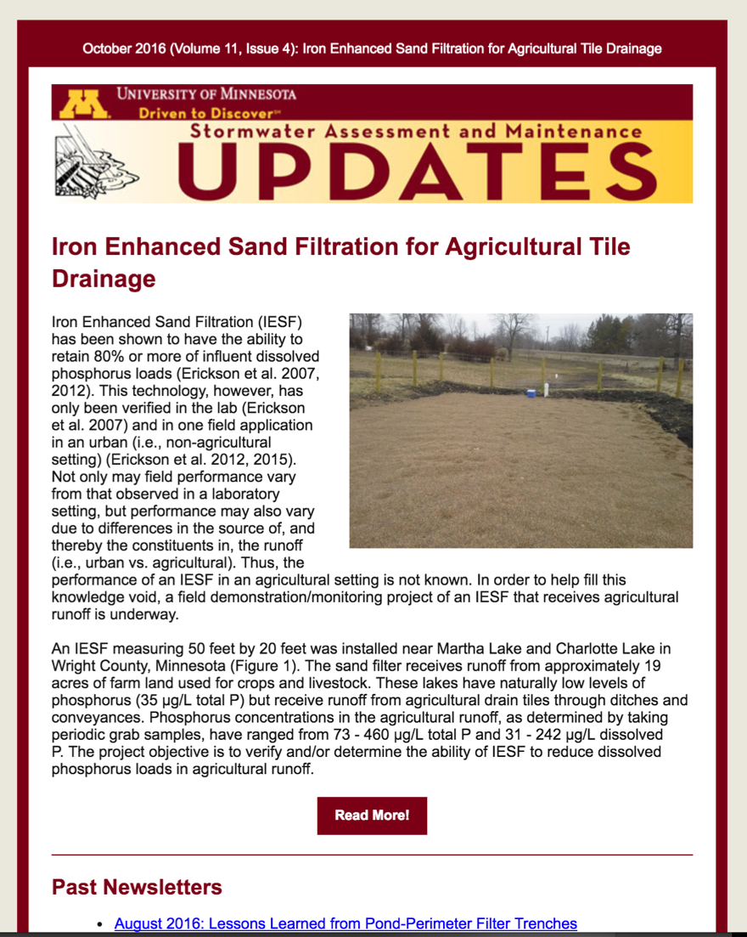
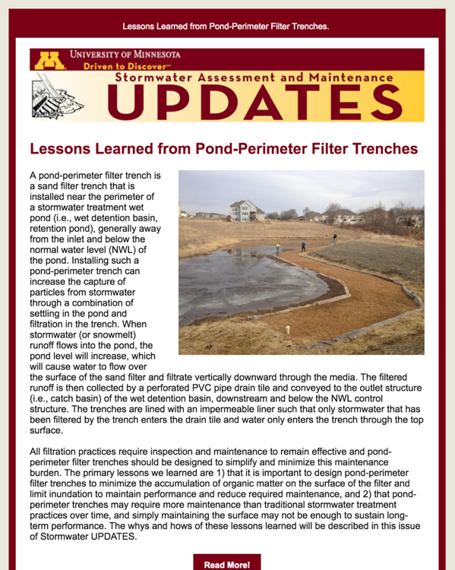
Stormwater UPDATES Newsletter
Signup at http://stormwater.safl.umn.edu/

Slide 23

Summary/Conclusions
Biofiltration practices are robust stormwater treatment practices that use physical, biological, and chemical treatment processes to remove pollutants, including phosphorus
Compost and sometimes topsoil are commonly added to support vegetation and rhizospheric biodegradation, but can release phosphate with the outflow
Solutions?
  Reduce the amount of compost used to 3 – 5%
  Test media for phosphorus content; compare to guidelines
  Add amendments such as WTR, iron, commercial sorbents, etc.

Slide 24
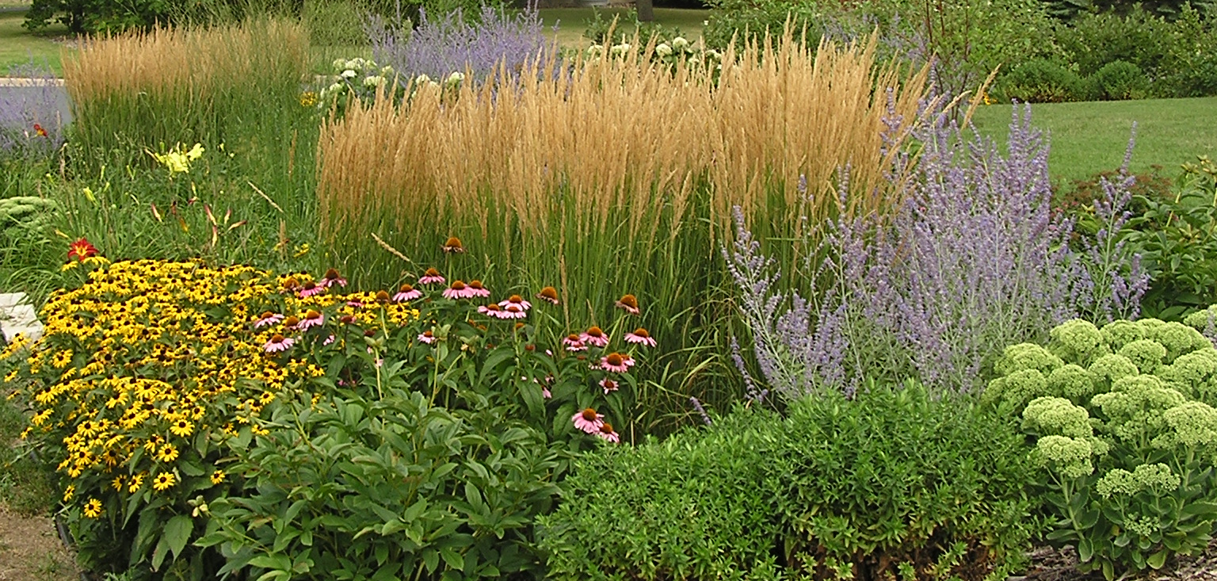
Thank You for Your Attention!
For more information, please contact:
Andy Erickson at eric0706@umn.edu
Photo courtesy: B. Asleson

