Slide 1
Minnesota Stormwater Manual Pretreatment Updates
June 18, 2019

Slide 2
Overview
Project Team & Roles
Overview of Pretreatment Work
Pretreatment Settling Practices Updates
Pretreatment Sizing Recommendations
Pretreatment Case Studies

Slide 3
3
Project Team & Roles
Katy Thompson, PE | RESPEC
Project Manager, Pretreatment Case Studies, Pretreatment Sizing
Scott Struck, PhD, PE | Geosyntec
Pretreatment Settling Practices and BMP Selection Tool
John Gulliver, PHD, PE
Pretreatment Sizing
Andy Erickson, PhD, PE
Filter Strips and Stormwater Manual update

Slide 4
Overview of Pretreatment Work
MN Stormwater Manual Update
New Features
Links

Slide 5
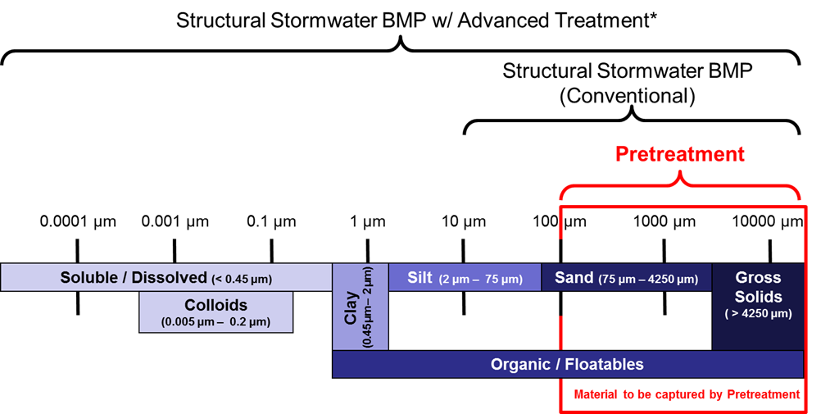
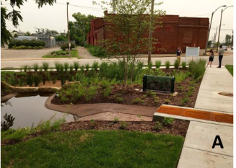
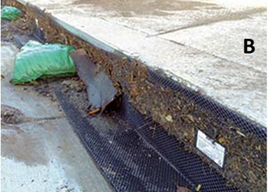
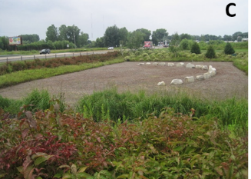
Overview of Pretreatment Work
Pretreatment (overview)
Importance
Methods
Practices
Settling devices
Screens
Vegetated filter strips
Cost considerations
Applicability
Compatibility with downstream structural stormwater BMPs
30+ cited references
https://stormwater.pca.state.mn.us/index.php?title=Overview_and_methods_of_pretreatment
Dr. Andy Erickson, PE

Slide 6
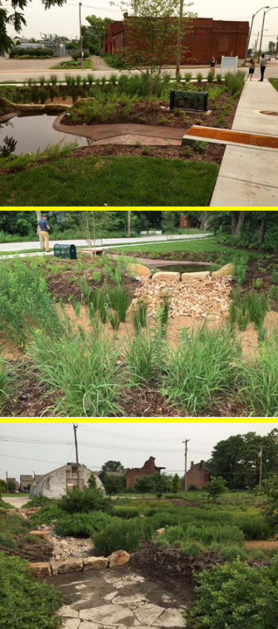
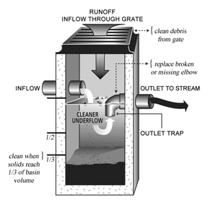
Overview of Pretreatment Work
Pretreatment Settling Devices
Processes
Applicability and suitability
Cold climate
Retrofit
Ultra-urban
Permit applicability
Advantages and limitations
Water quantity treatment (volume reduction)
Water quality treatment (performance)
Certification programs
https://stormwater.pca.state.mn.us/index.php?title=Overview_and_methods_of_pretreatment
Dr. Andy Erickson, PE

Slide 7
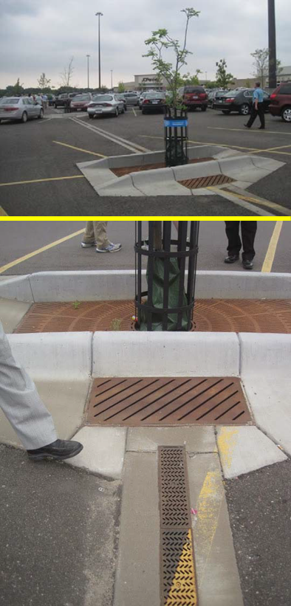
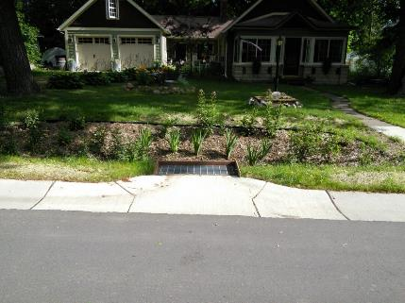
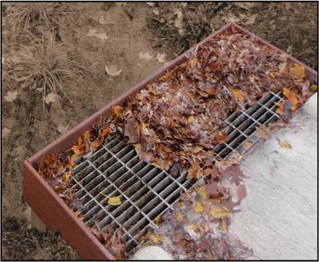
Overview of Pretreatment Work
Pretreatment Screens
Processes
Applicability and suitability
Cold climate
Retrofit
Ultra-urban
Permit applicability
Advantages and limitations
Water quantity treatment (volume reduction)
Water quality treatment (performance)
https://stormwater.pca.state.mn.us/index.php?title=Overview_for_pretreatment_screens
Dr. Andy Erickson, PE

Slide 8
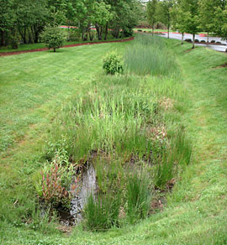
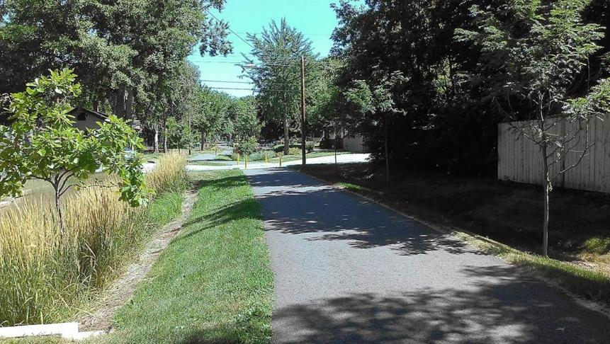
Overview of Pretreatment Work
Pretreatment Vegetated Filter Strips
Processes
Applicability and suitability
Cold climate
Retrofit
Ultra-urban
Permit applicability
Advantages and limitations
Water quantity treatment (volume reduction)
Water quality treatment (performance)
https://stormwater.pca.state.mn.us/index.php?title=Overview_for_pretreatment_vegetated_filter_strips
Dr. Andy Erickson, PE

Slide 9
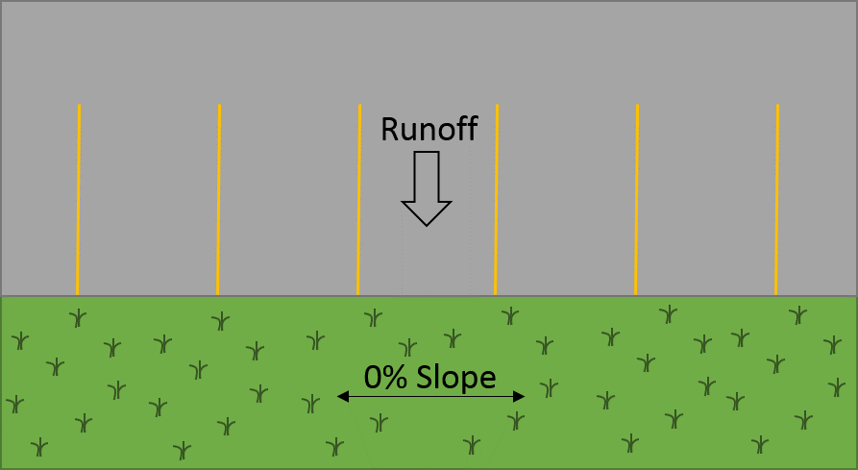
Overview of Pretreatment Work
Design, Construction, Operation and Maintenance: Pretreatment Vegetated Filter Strips
Design criteria
Construction specifications
Operation and maintenance
+20 cited references
https://stormwater.pca.state.mn.us/index.php?title=Design,_construction,_operation_and_maintenance_specifications_for_pretreatment_vegetated_filter_strips
Dr. Andy Erickson, PE

Slide 10
Pretreatment Settling Practices
Pretreatment Settling Practices Updates
Pretreatment Selection Tool
Demonstration

Slide 11
Pretreatment Settling Practices Updates
11
Pretreatment is a required part of infiltration and filtration practices covered under the Minnesota Construction Stormwater General Permit
Objective:
Provide design criteria and considerations, construction guidelines, and maintenance recommendations for stormwater pretreatment controls
three general types of pretreatment practices
Settling Devices
Screens
Vegetated Filter Strips

Slide 12
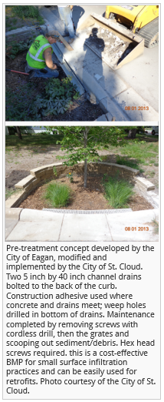
Pretreatment Settling Practices Updates
12
Detailed pretreatment functional process for pollutant removal
List of (Primary) Processes
Hydrodynamic Separation Devices
Screening and Straining Devices
Above Ground and Below Grade Storage and Settling Systems
Filtration Practices
Other Water Quality Devices
Organization
Each functional process section is subdivided into:
Pretreatment Overview
Process Summary and Pollutant Removal
System Design and Sizing Information
Installation Recommendations, Inspection, and Operation and Maintenance
Numerous references to manufacturer or assessment websites to assist with design, construction, performance, and operation and maintenance

Slide 13
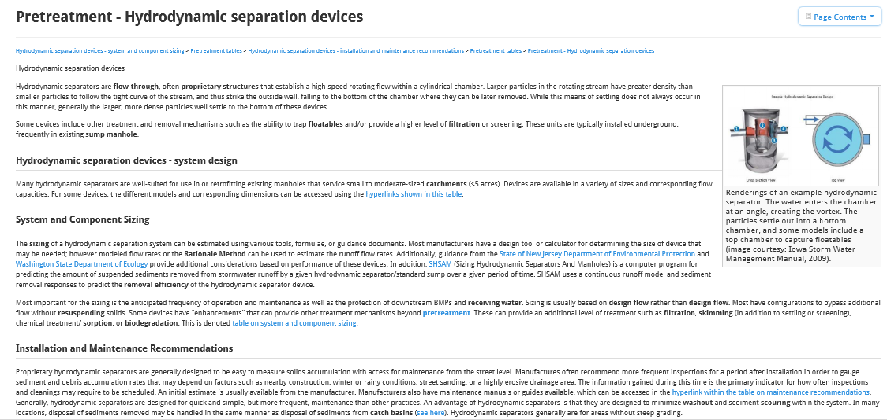
Hydrodynamic Separation Devices
13
Pretreatment Wiki Page
Hyperlinked Text

Slide 14
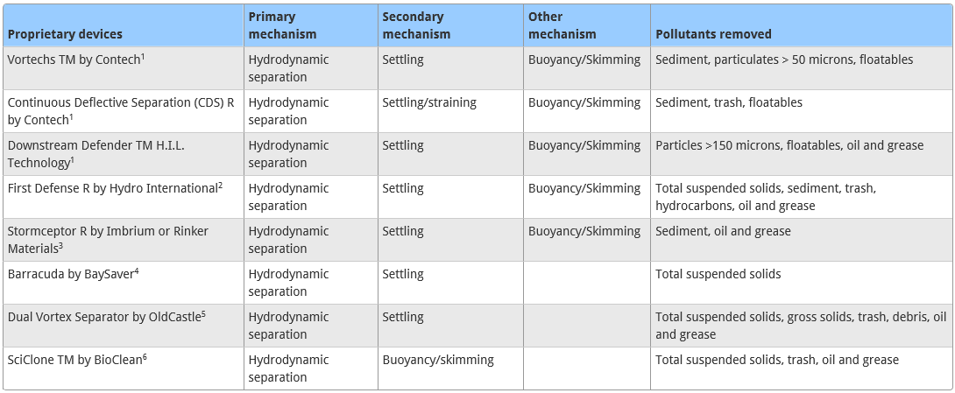
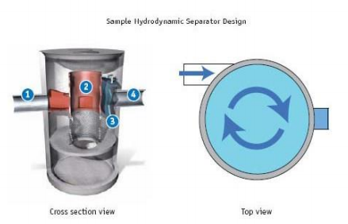
Hydrodynamic Separation Devices
14
Flow-through, often proprietary structures that establish a high-speed rotating flow within a cylindrical chamber
Treatment Mechanisms
General Pollutants Removed

Slide 15
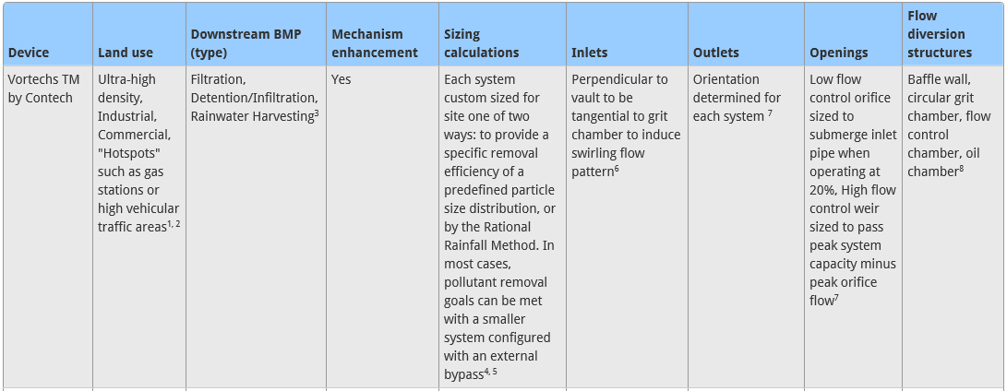
Hydrodynamic Separation Devices
15
System Sizing and Design Information
Typical Land Use Applied
Compatible Downstream Practice
Sizing Calculations
Inlets and Outlets
Openings
Flow Diversion Structures

Slide 16
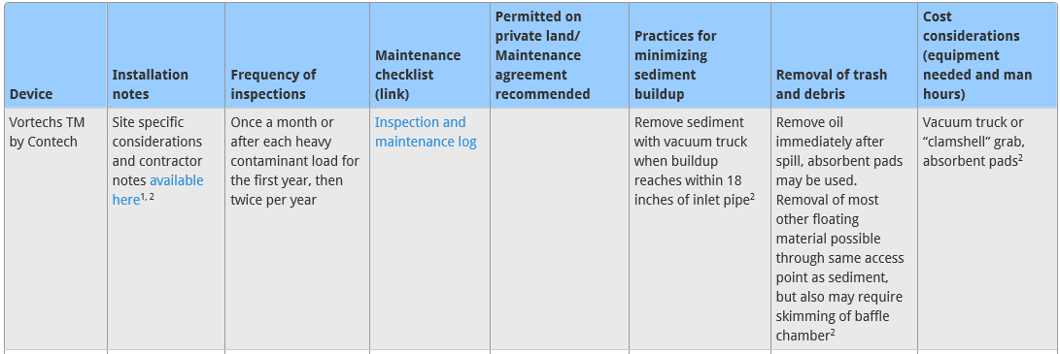
Hydrodynamic Separation Devices
16
Installation Recommendations, Inspection, and Operation and Maintenance
Installation Considerations
Inspection Frequency
Typical Maintenance
Public/ Private Considerations
Minimize Maintenance
Cost Considerations
Hyperlinked Text
Linked References

Slide 17
Hydrodynamic Separation Devices
17
Navigation Links to Tabular Information

Slide 18
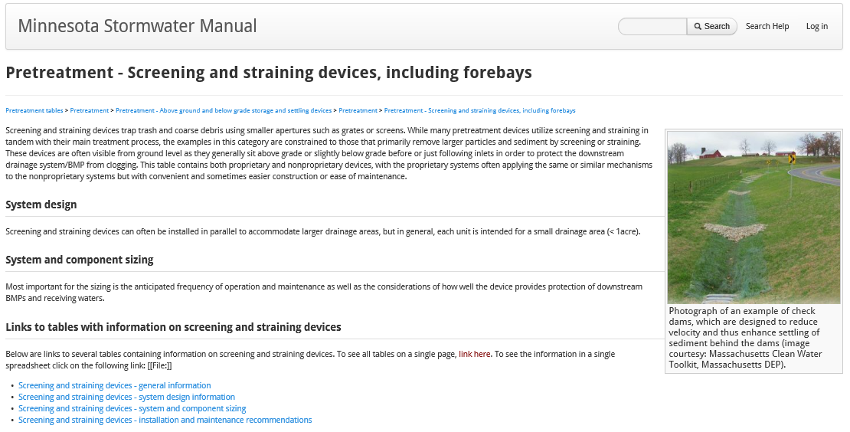
Screening and Straining devices
18

Slide 19
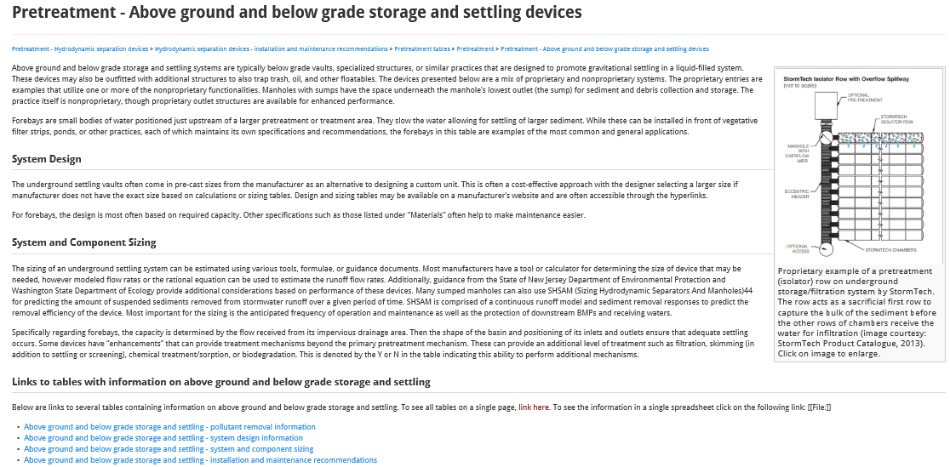
Above ground and below grade storage and settling devices
19

Slide 20
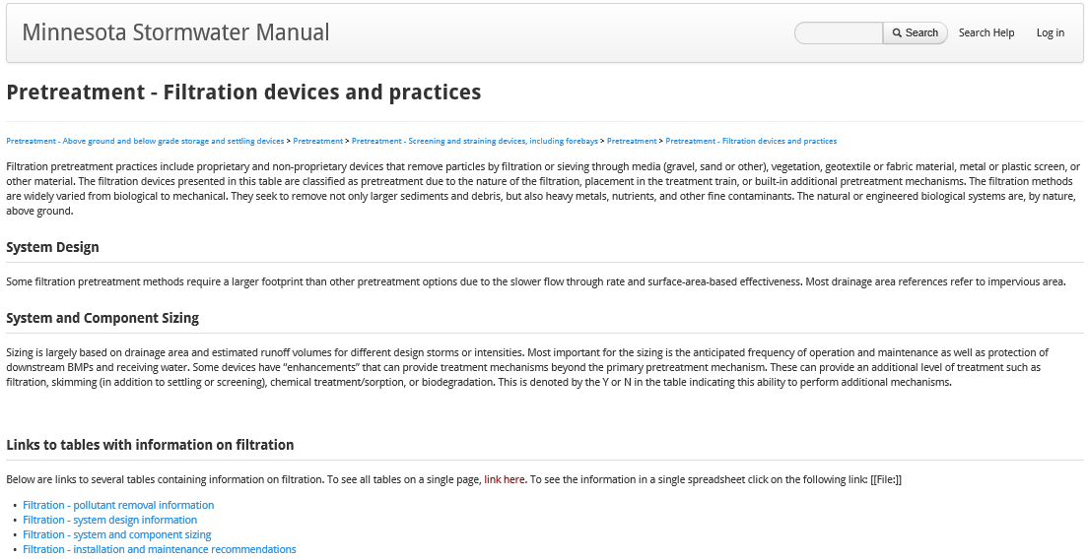
Filtration devices and practices
20

Slide 21
Other pretreatment water quality devices and practices
21

Slide 22
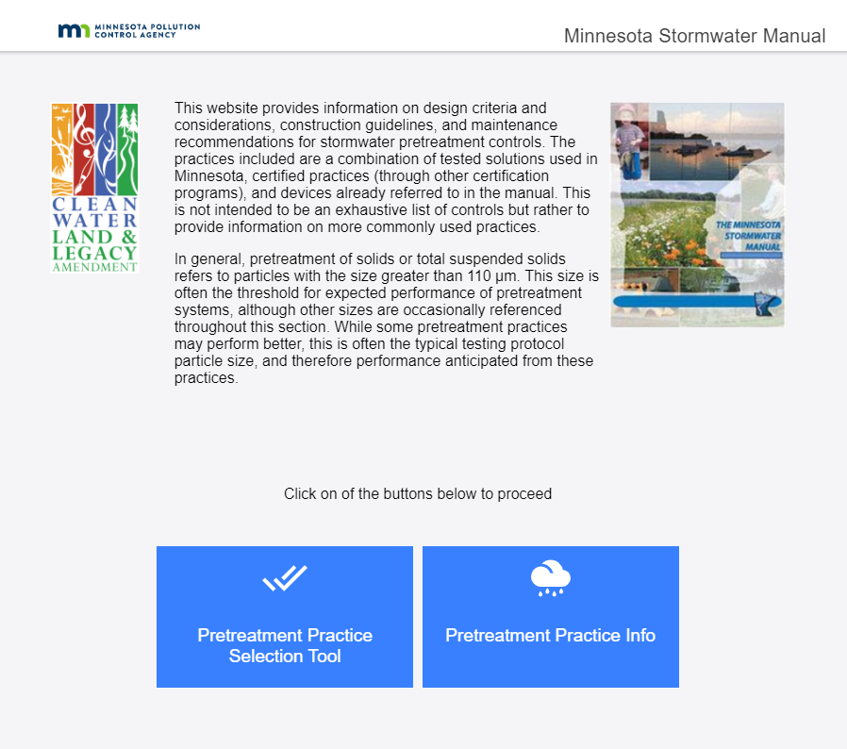
Pretreatment Selection Tool
22

Slide 23
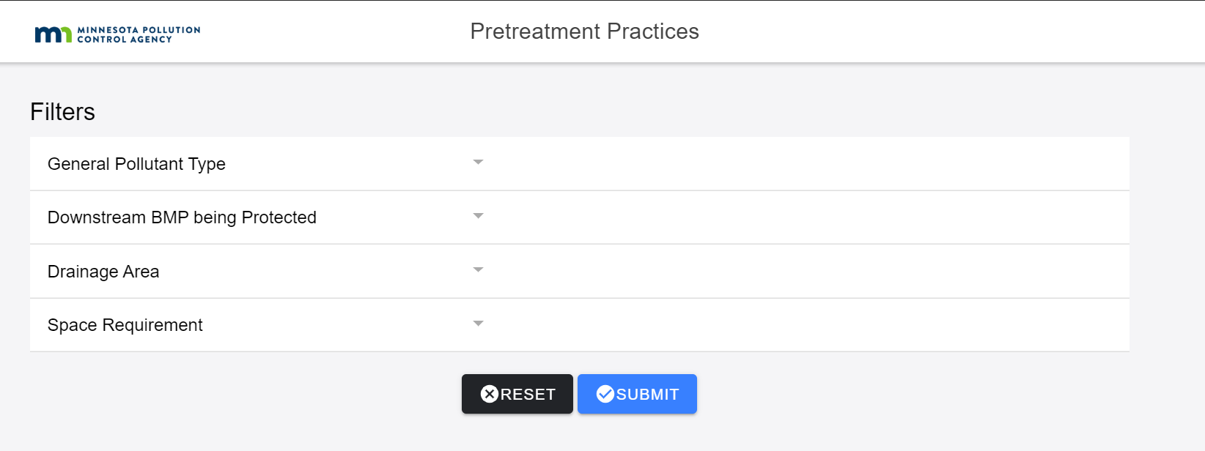
Filtering Categories
23
System Sizing and Design Information (select up to four)
General Pollutant Type
Downstream BMP Protected
Drainage Area
Space Requirements

Slide 24
General Pollutant Type
24
Mineral and Organic Solids
Floatables
Oil and Grease

Slide 25
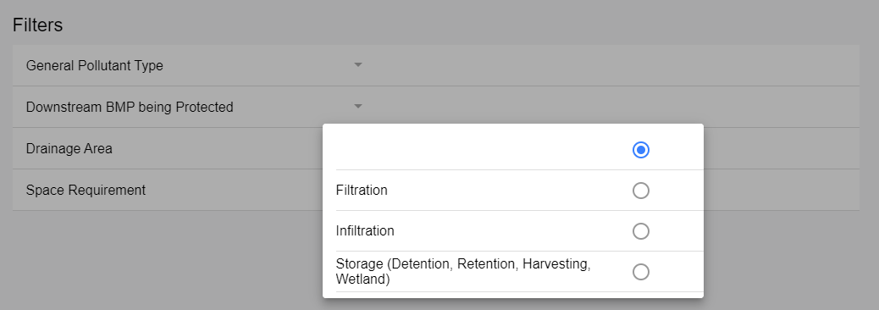
Downstream BMP being Protected
25
Filtration
Infiltration
Storage

Slide 26
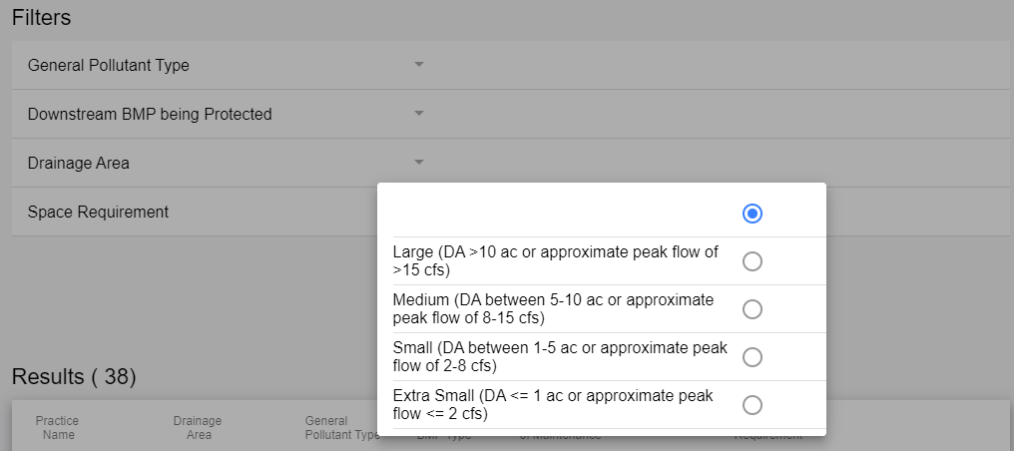
Drainage Area
26
Large
Medium
Small
Extra Small

Slide 27
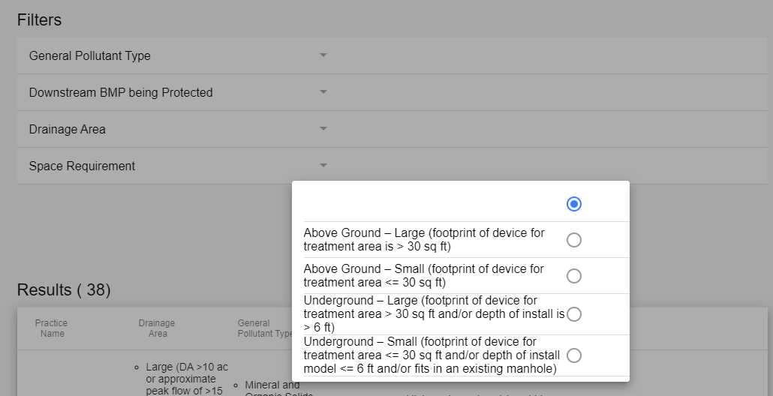
Space Requirements
27
Above Ground - Large
Above Ground - Small
Underground – Large and/or Deep
Underground – Small and/or Shallow

Slide 28
Results
28
Equipment cost (e.g., hire a professional or specialized equipment
Is confined space entry certification may be required?
Labor hours
Inspection frequency

Slide 29
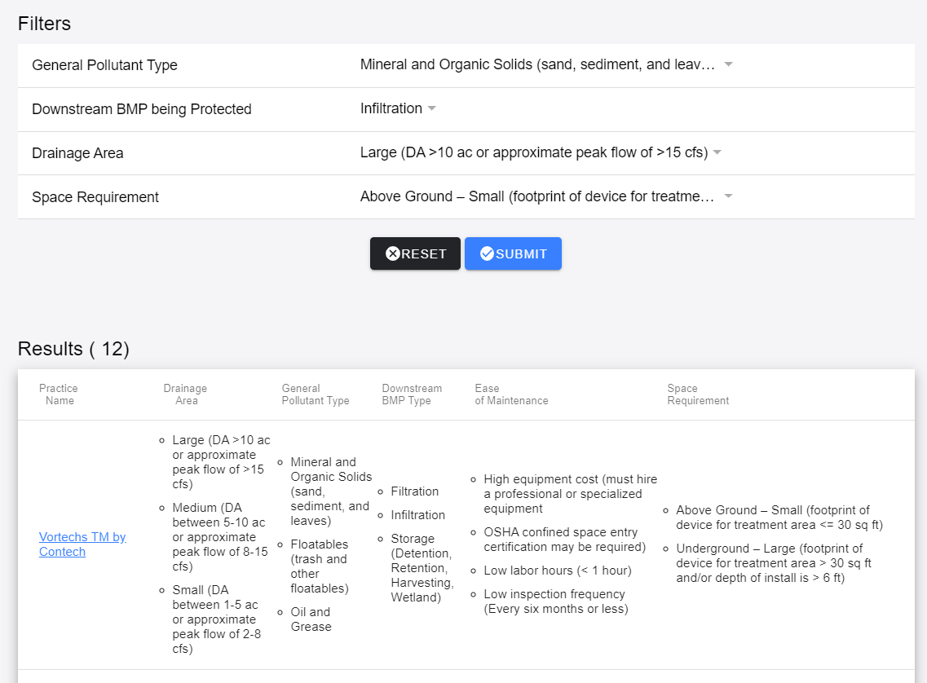
Filtered Data Results
29

Slide 30
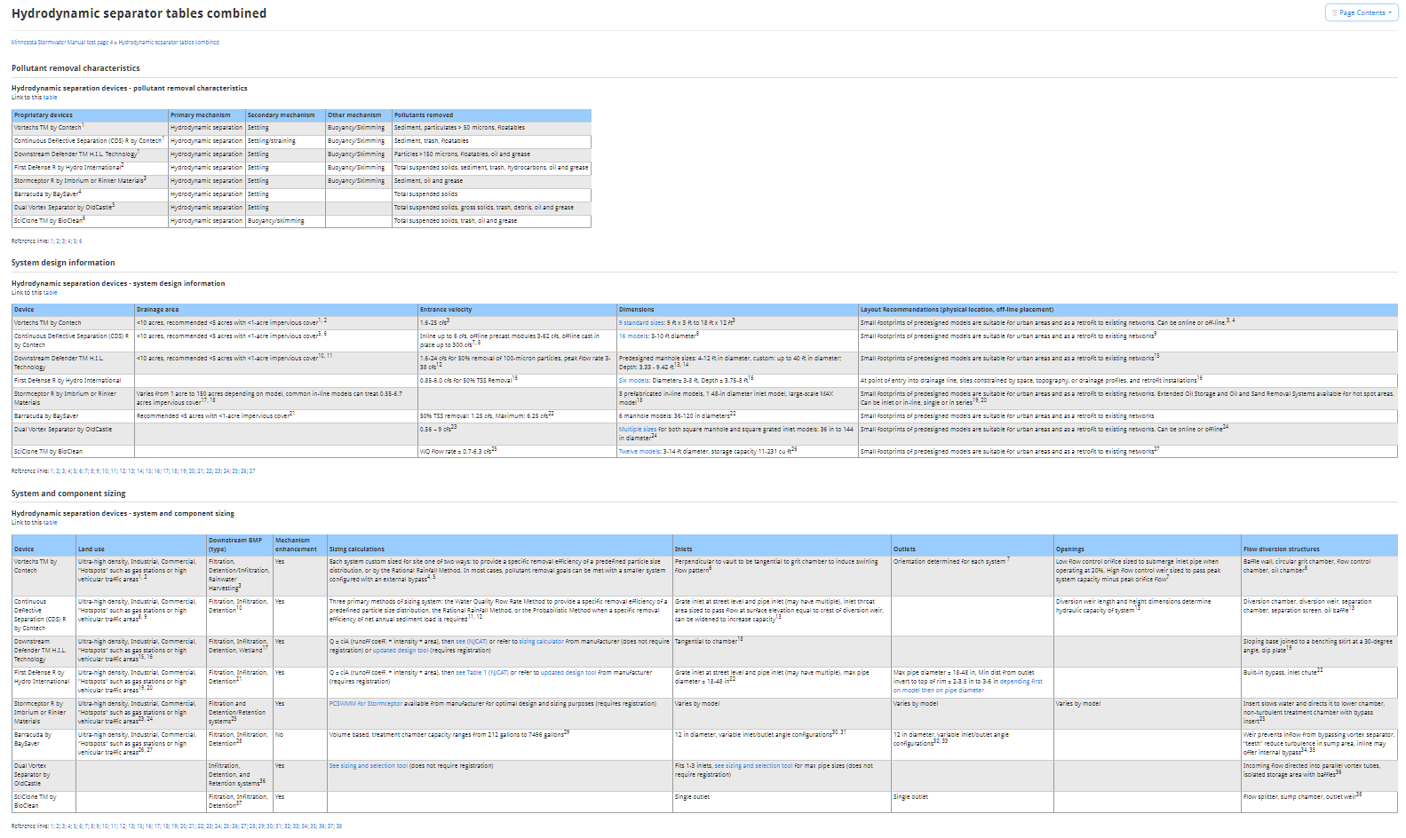
Practice Details
30
Text Information
Comparative Tables

Slide 31
Pretreatment Sizing Recommendations
State Comparisons
Preliminary Sizing Recommendations
Rock Filter Strip
Vegetated Filter Strip
Sump

Slide 32
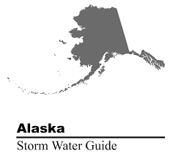
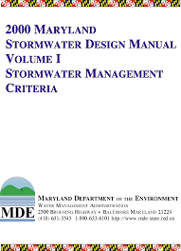
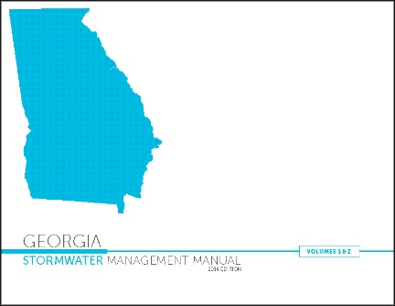
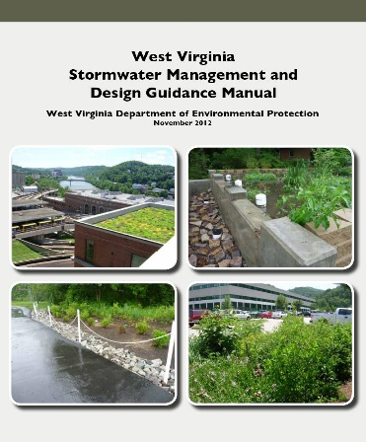
Pretreatment Around the Country
32
Reviewed all 50 states’ stormwater permits and manuals (if exist)
Not all states explicitly require pretreatment
A lot of variation in design criteria
https://stormwater.pca.state.mn.us/index.php?title=Stormwater_manuals

Slide 33
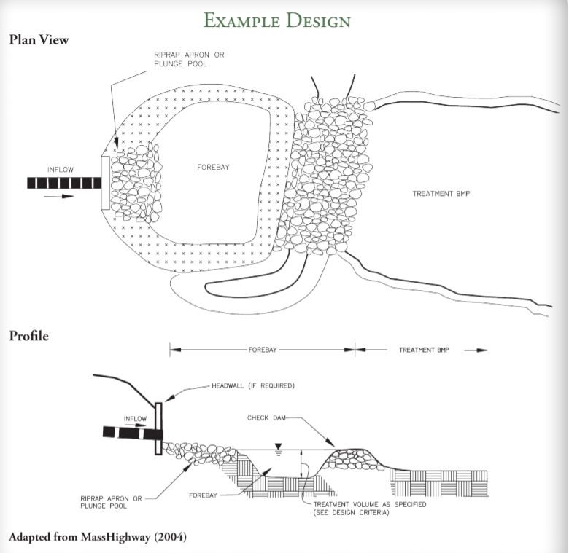
Forebays
33

Slide 34
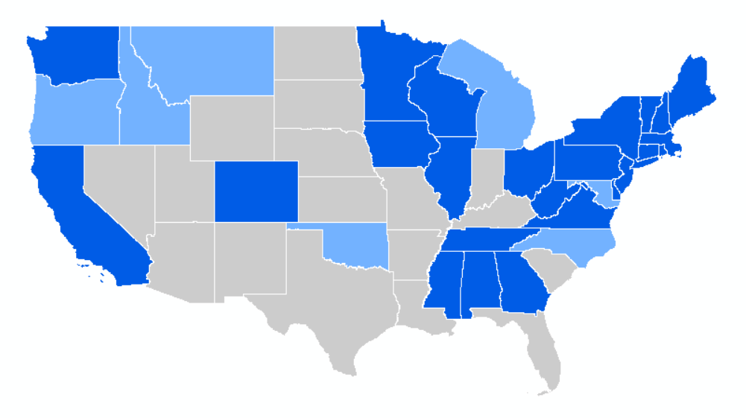
States with Detailed Design Criteria
34

Slide 35
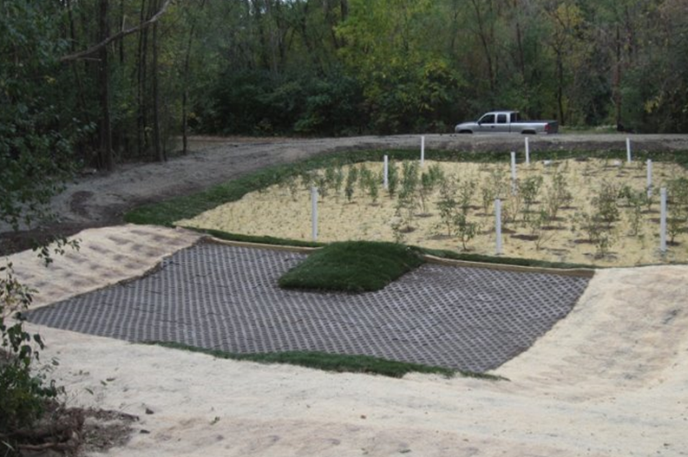
Forebay findings
35
sizing Criteria Examples include:
0.1-in of runoff per impervious acre
1- to 10% of water quality volume
1- to 40% of BMP total runoff volume
10 storms per year * Sanded Area (ac) * 500lb/ac-storm / 90 lb/cf
Minnesota Stormwater Manual:
10% of water quality volume and 4- to 6-ft deep, recommended

Slide 36
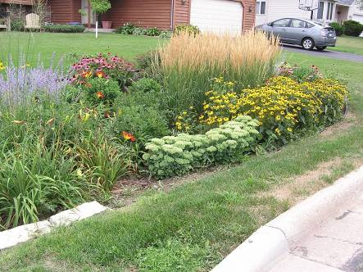
Pretreatment Sizing Recommendations
36
Why is sizing important for the manual?
Many smaller treatment facilities (bioretention/biofiltration or rain gardens) do not have a pretreatment sizing criteria and are too small to justify hiring an engineer.
Larger treatment practices (e.g., ponds, infiltration basins, roadside swales) could use a simple preliminary design methodology for pretreatment.
What are we considering?
Preliminary sizing criteria is being developed from the watershed’s impermeable area, the design storm intensity, the settling velocity of the targeted particle size, and the fraction of that size to be removed.
What will be the result?
Sizing criteria for the area of filter strips and the surface area of basins, and recommendations on the depth of basins.

Slide 37
Pretreatment Case Studies
Participants
Example Case Studies
Vegetated Filter Strip
Rock Filter Strip
Forebay
Links

Slide 38
THANK YOU!!!
38

Slide 39
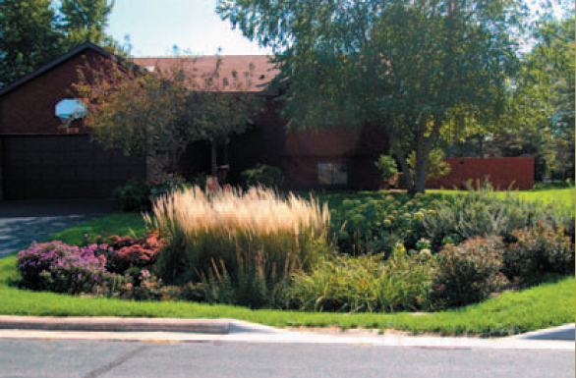
Vegetated Filter Strips
AT-A-GLANCE
City of Burnsville
Provide pretreatment from street runoff prior to entering residential raingardens
Vegetated filter strips have a lifespan of 5 to 7 years, but have prolonged the lifespan and reduced maintenance of the rain gardens
Incorporate “drop waterfalls” at curb cutout to slow the speed and reduce erosion potential of the runoff entering the vegetated filter strip.

Slide 40
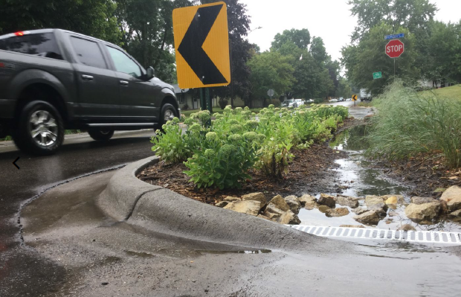
Rock Filter Strips
AT-A-GLANCE
City of Fridley
Provide pretreatment from street runoff prior to entering curb-cut bioswales
Blocked inlets can cause stormwater to bypass the basin.
Initial rocks in filter strips were too small, which resulted in rocks getting carried into the bioswale during larger rain events.
Trial-and-error showed Class I riprap was the appropriate rock size (3 – 6 inches in diameter)

Slide 41
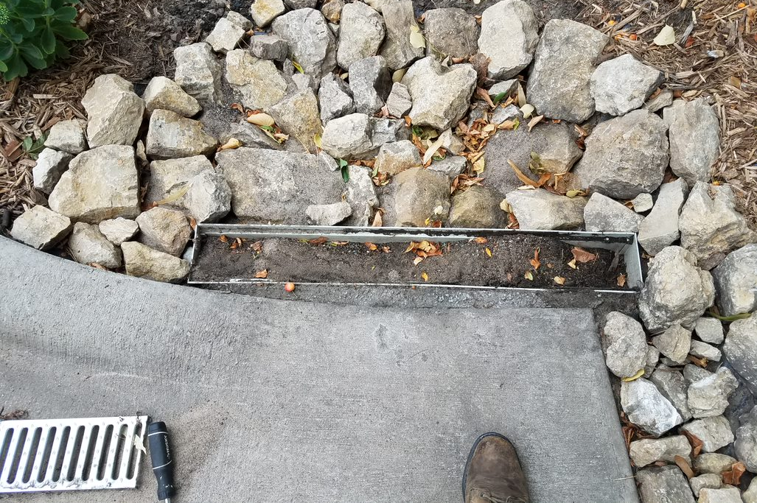
Rock Filter Strips
AT-A-GLANCE
City of Fridley
Regular maintenance has prolonged lifespan and function
Delegated maintenance responsibilities to contractor resulted in more consistent maintenance & better results.
41

Slide 42
Sediment Forebay
AT-A-GLANCE
City of South St. Paul/Dakota County SWCD
Forebay cell designed to promote the longevity of the iron-enhanced sand filter cell
Level spreader weirs distribute flows evenly into pretreatment cell
Turfstone pavers facilitate sediment maintenance

Slide 43
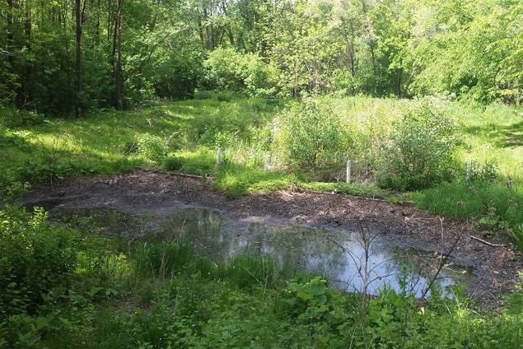
Sediment Forebay
AT-A-GLANCE
City of South St. Paul/Dakota County SWCD
The turfstone and weir design are successfully capturing large amounts of sediment
Forebay has experienced significant surface ponding
Future designs would include underdrains to facilitate proper drainage with poor/compacted soils
Vaccuum turfstone to remove layer of fine sediment at paver surface and replace with washed sand during regular maintenance.

Slide 44
PRETREATMENT CASE STUDIES
44
Full case studies can be found at:
https://stormwater.pca.state.mn.us/index.php?title=Case_studies_for_pretreatment

Slide 45
Thank you & Questions?
Katy Thompson
katy.thompson@respec.com
651.305.2275
Scott Struck
SStruck@Geosyntec.com
303.586.8194
John Gulliver
gulli003@umn.edu
Andy Erickson
eric0706@umn.edu

